Slide 1
Long-Mann 16-Bit RISC Processor
Final DESIGN REVIEW presentation
Taylor Long, Jared Mann
Notes:
Jared

Slide 2
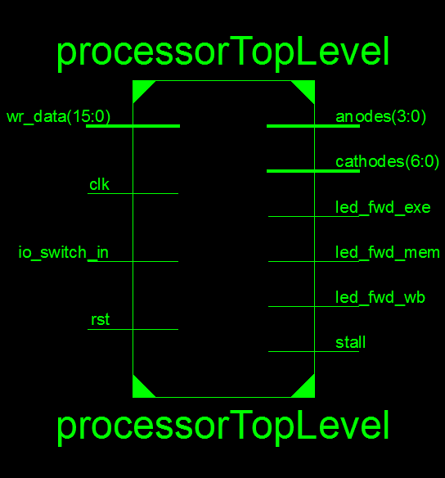
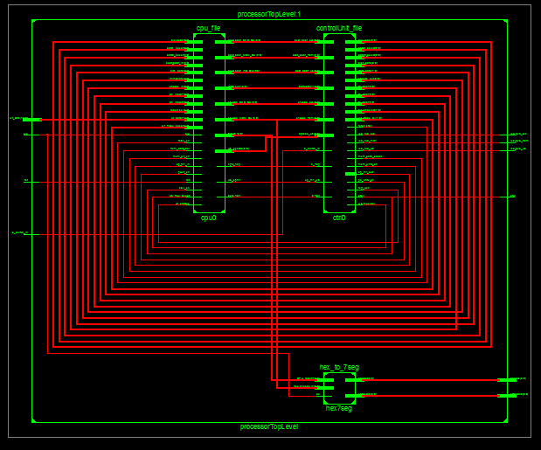
High Level Overview
Hierarchy and RTL SCHEMATIC
Notes:
Jared

Slide 3
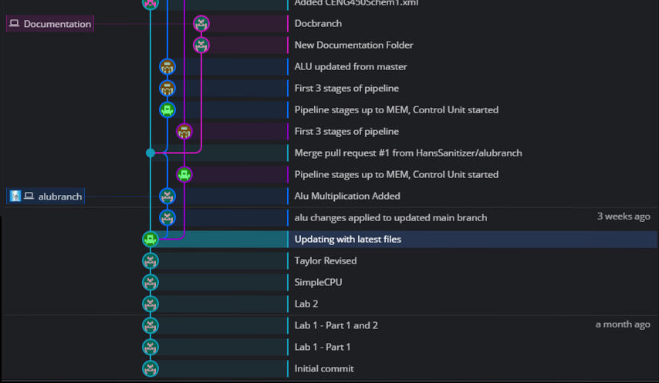
Development Timeline – Note (will remove later): These times in reference to 9pm 3/26/2017
FIRST STEPS – SIMPLE CPU, ALU, STARTING CONTROL UNIT AND PIPELINE STAGES
Notes:
Jared – A month ago completed Labs, 3 weeks ago had simple cpu, Started Collaboration Through Github for having a backed up version of project, allowed us to work concurrently on different aspects of project, Keep ongoing documentation.

Slide 4
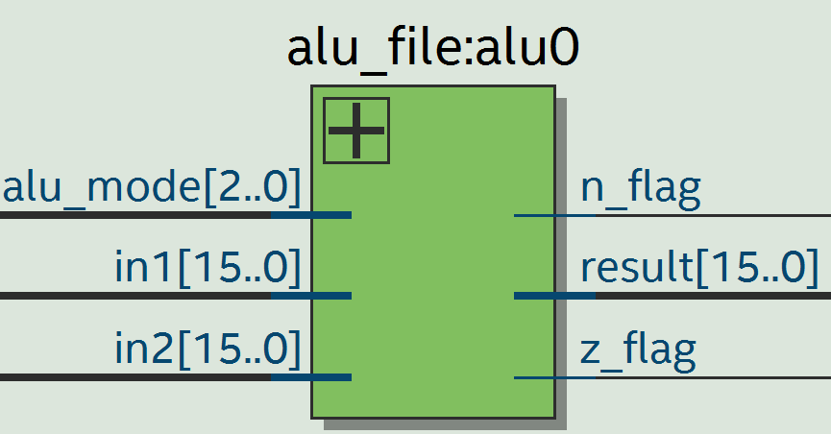
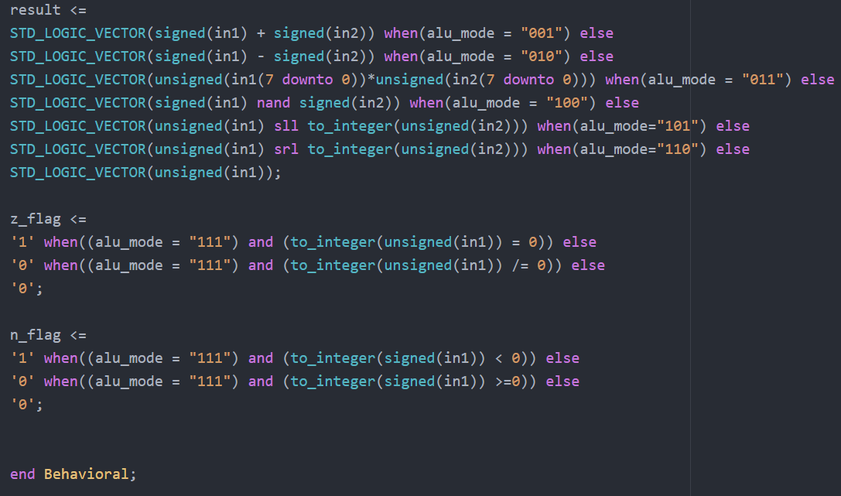
THE FINISHED ALU
The ALU is capable of producing results in all modes
Multiplication is done by taking the 8 LSB’s of in1 and in2 and producing a 16-bit result
The ALU operates asynchronously, improving performance
Notes:
Jared

Slide 5
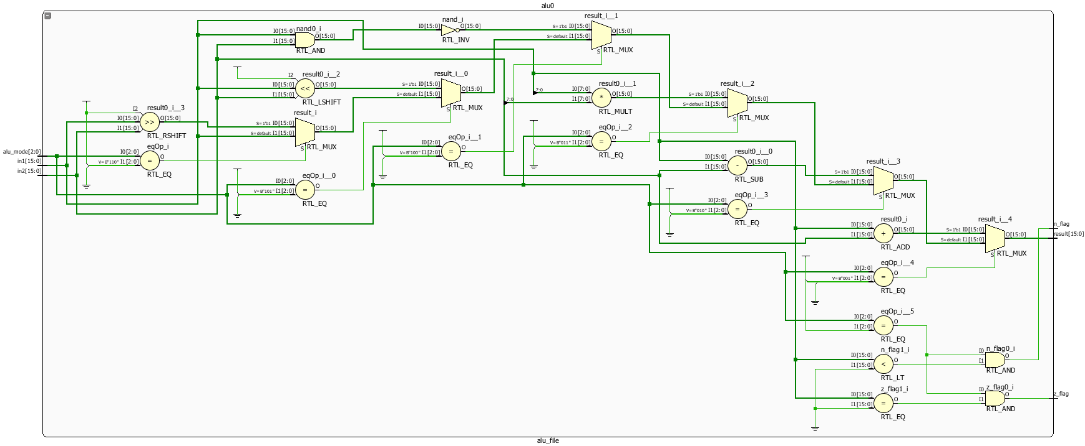
THE FINISHED ALU – RTL SCHEMATIC, PERFORMANCE
HDL Synthesis Report
Macro Statistics
# Multipliers : 1
8x8-bit multiplier : 1
# Adders/Subtractors : 1
16-bit addsub : 1
# Comparators : 1
16-bit comparator less : 1
# Logic shifters : 2
16-bit shifter logical left : 1
16-bit shifter logical right : 1
Timing Summary:
Speed Grade: -5
Minimum period: No path found
Minimum input arrival time before clock: No path found
Maximum output required time after clock: No path found
Maximum combinational path delay: 14.386ns
Notes:
Jared – Each module we made was evaluated in RTL schematics to see if there were any glaring issues. This module had no latches.

Slide 6
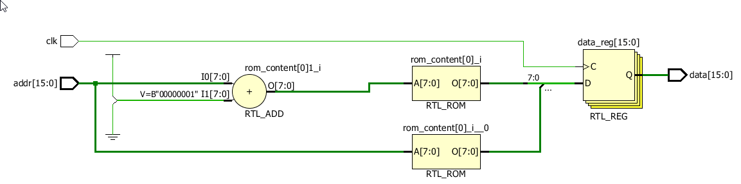
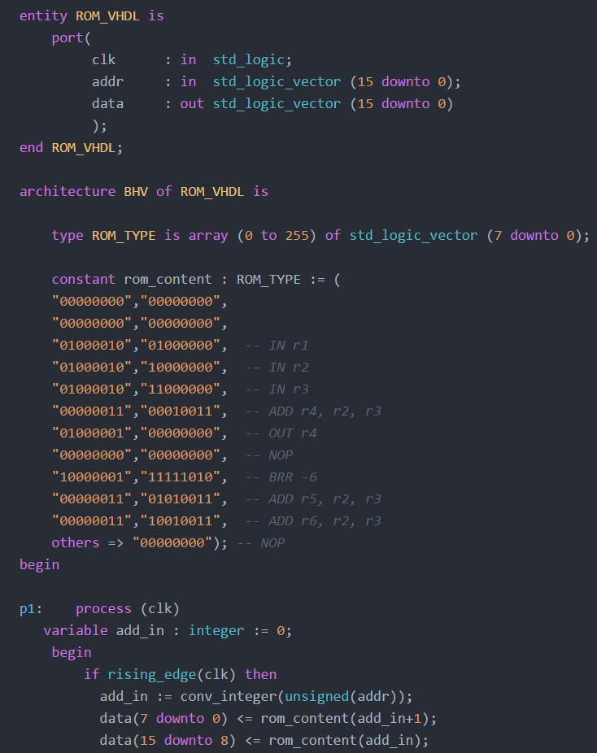
THE ROM FILE
The Contents of The ROM File are byte addressable, word aligned
Notes:
Taylor

Slide 7
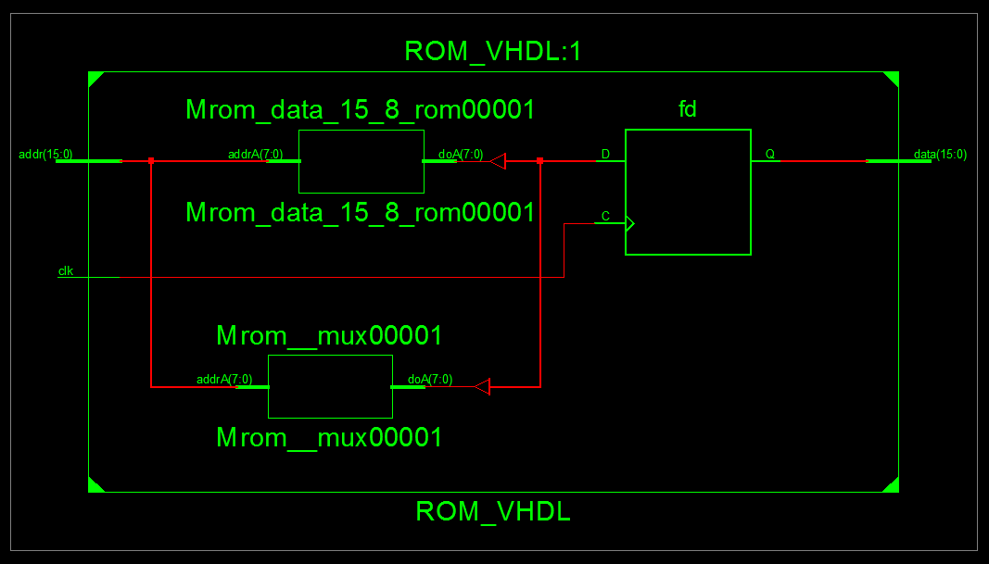
THE ROM FILE – PERFORMANCE AND RTL SCHEMATIC
Advanced HDL Synthesis Report
Macro Statistics
# RAMs : 2
255x8-bit single-port block RAM : 1
256x8-bit single-port block RAM : 1
Timing Summary:
Speed Grade: -5
Minimum period: No path found
Minimum input arrival time before clock: 1.814ns
Maximum output required time after clock: 5.962ns
Maximum combinational path delay: No path found
Notes:
Taylor.

Slide 8
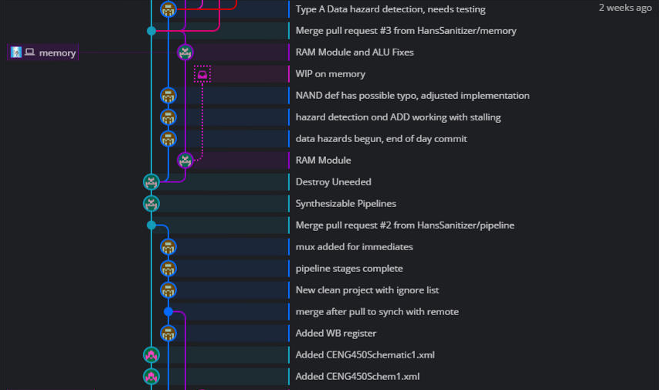
Development Timeline
FINISHING PIPELINE STAGES, RAM MODULE, BEGINNING HAZARDS
Notes:
Taylor

Slide 9
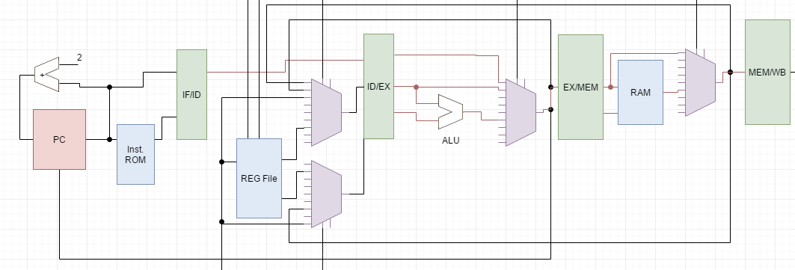
Pipeline Stages
ID/EXE
EXE/MEM
MEM/WB
IF/ID

Slide 10
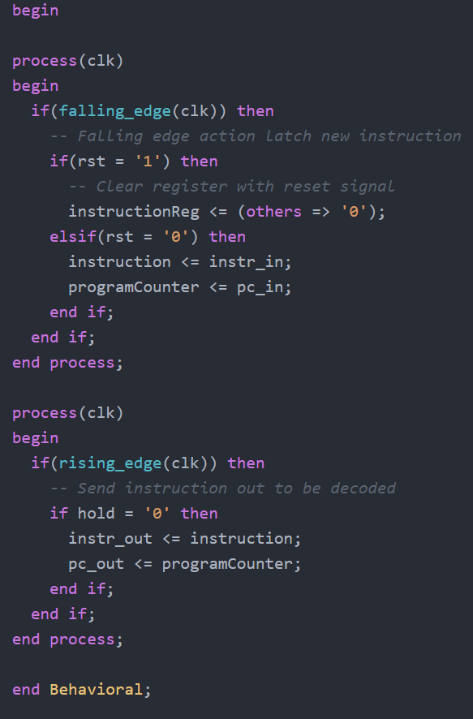
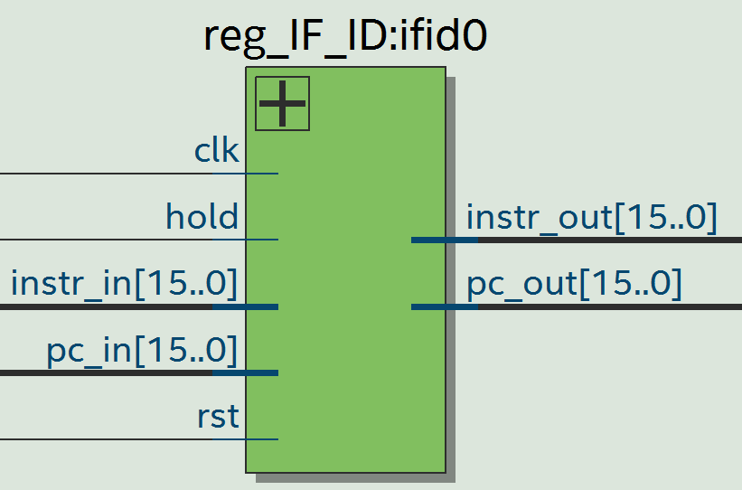
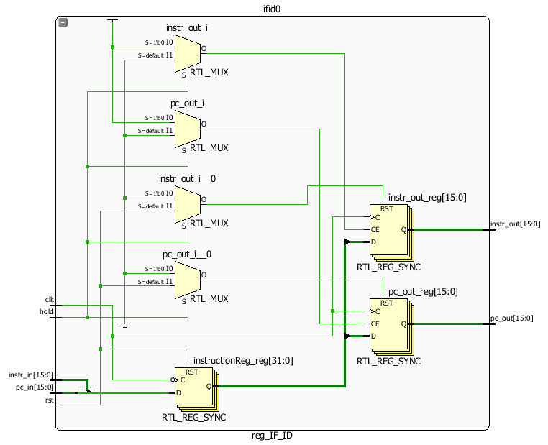
Pipeline Stages – Instruction Fetch / Instruction Decode

Slide 11
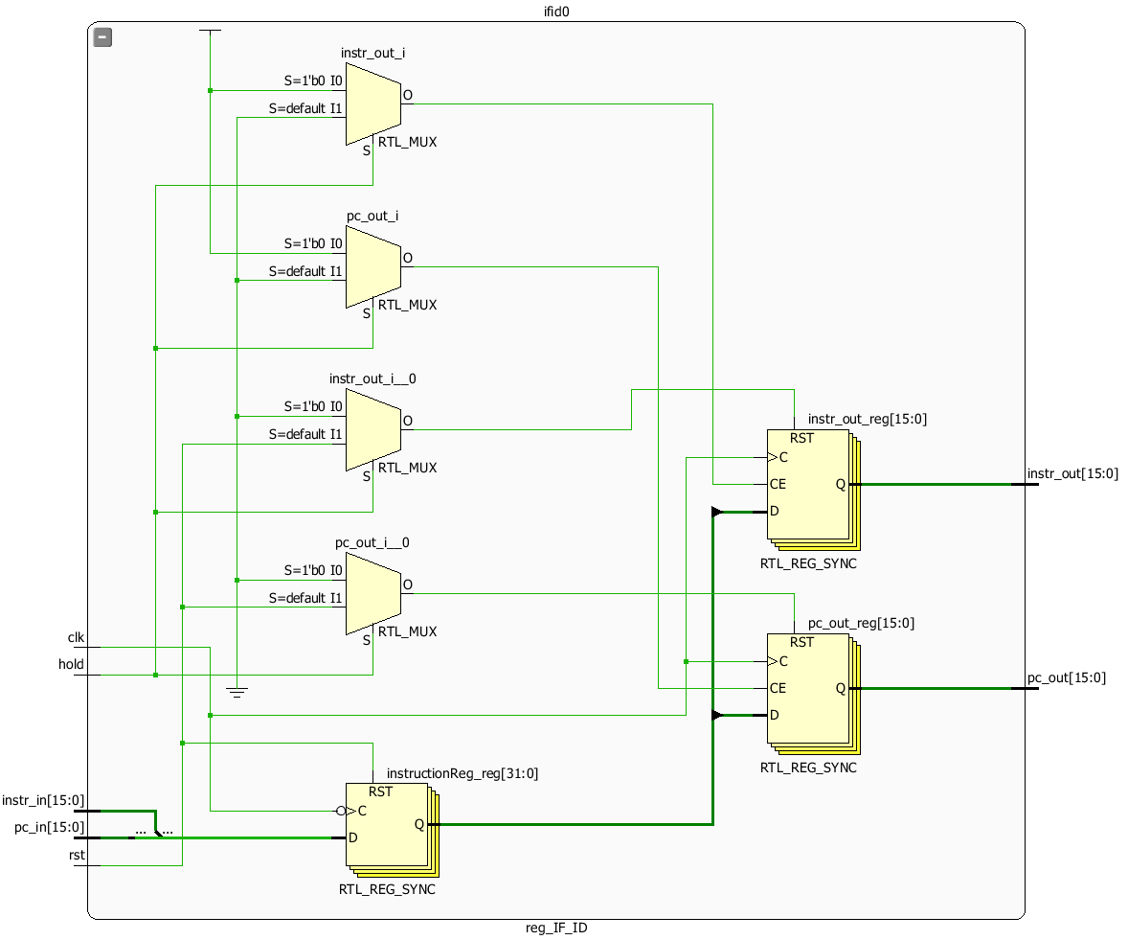
Pipeline Stages – Instruction Fetch / Instruction Decode – RTL SCHEMATIC
HDL Synthesis Report
Macro Statistics
# Registers : 34
1-bit register : 32
16-bit register : 2
Timing Summary:
---------------
Speed Grade: -5
Minimum period: 2.278ns (Maximum Frequency: 438.982MHz)
Minimum input arrival time before clock: 3.631ns
Maximum output required time after clock: 4.040ns
Maximum combinational path delay: No path found
=========================================================================

Slide 12
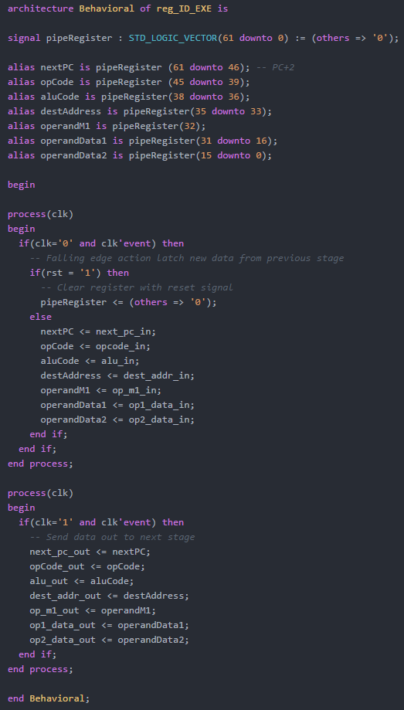
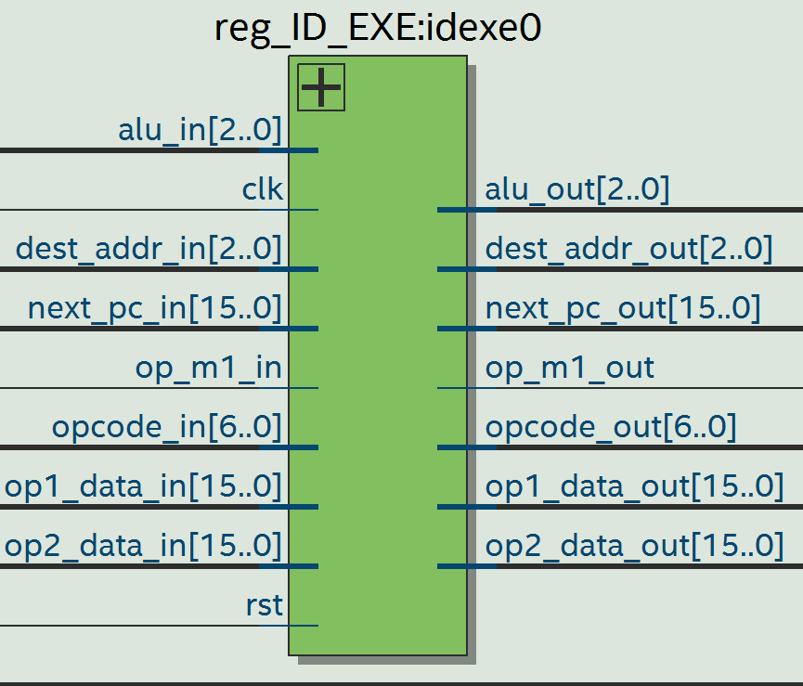
Pipeline Stages – Instruction DECODE / EXECUTION

Slide 13

Pipeline Stages – Instruction DECODE / EXECUTION – RTL SCHEMATIC, PERFORMANCE
HDL Synthesis Report
Macro Statistics
# Registers : 69
1-bit register : 63
16-bit register : 3
3-bit register : 2
7-bit register : 1
Timing Summary:
---------------
Speed Grade: -5
Minimum period: 2.278ns (Maximum Frequency: 438.982MHz)
Minimum input arrival time before clock: 2.982ns
Maximum output required time after clock: 4.040ns
Maximum combinational path delay: No path found

Slide 14
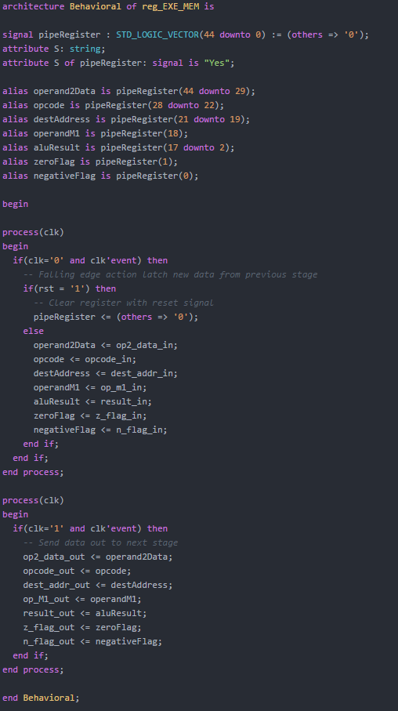
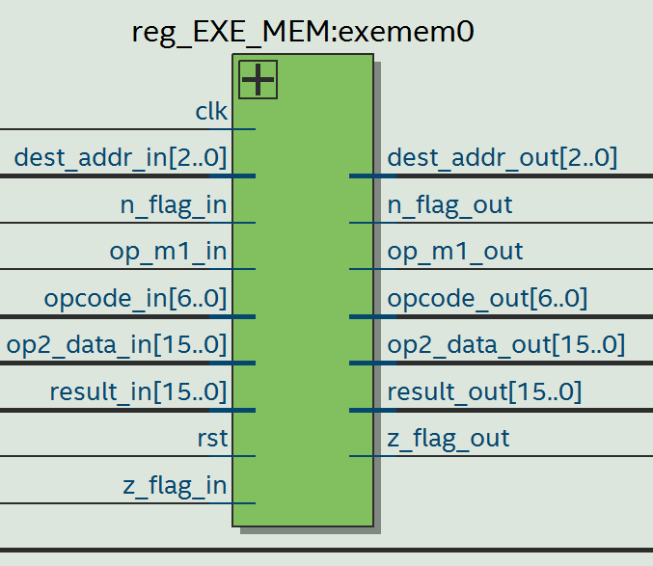
Pipeline Stages – EXECUTION / MEMORY

Slide 15
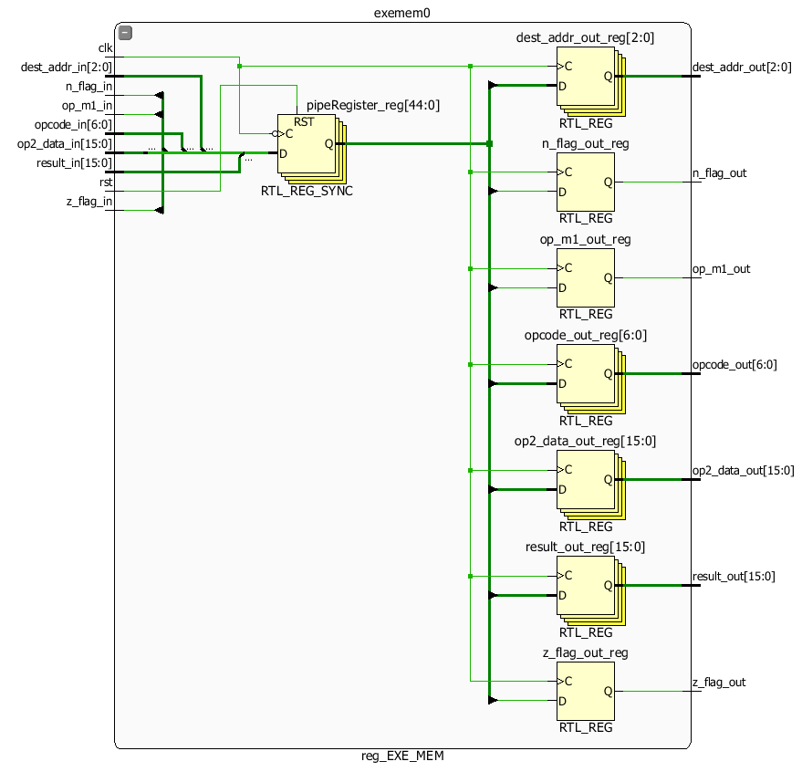
Pipeline Stages – EXECUTION / MEMORY – RTL SCHEMATIC, PERFORMANCE
HDL Synthesis Report
Macro Statistics
# Registers : 52
1-bit register : 48
16-bit register : 2
3-bit register : 1
7-bit register : 1
Timing Summary:
---------------
Speed Grade: -5
Minimum period: 2.278ns (Maximum Frequency: 438.982MHz)
Minimum input arrival time before clock: 2.977ns
Maximum output required time after clock: 4.040ns
Maximum combinational path delay: No path found

Slide 16
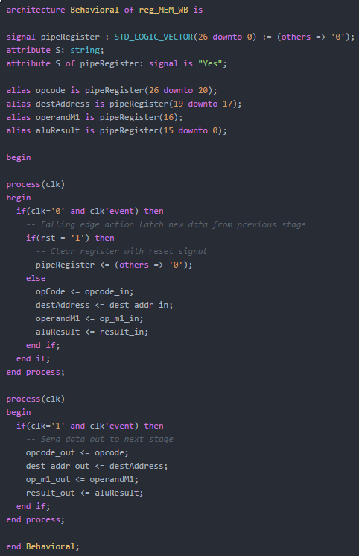
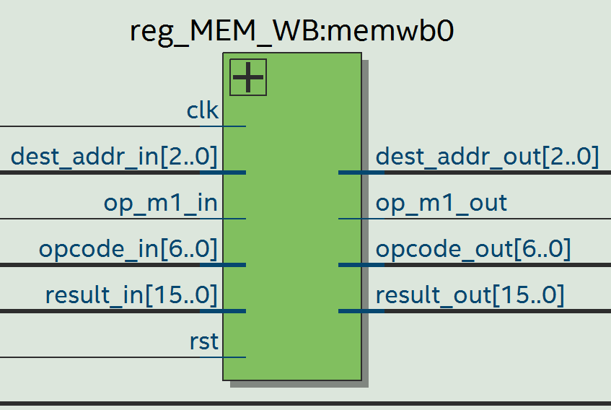
Pipeline Stages – Memory / Writeback

Slide 17
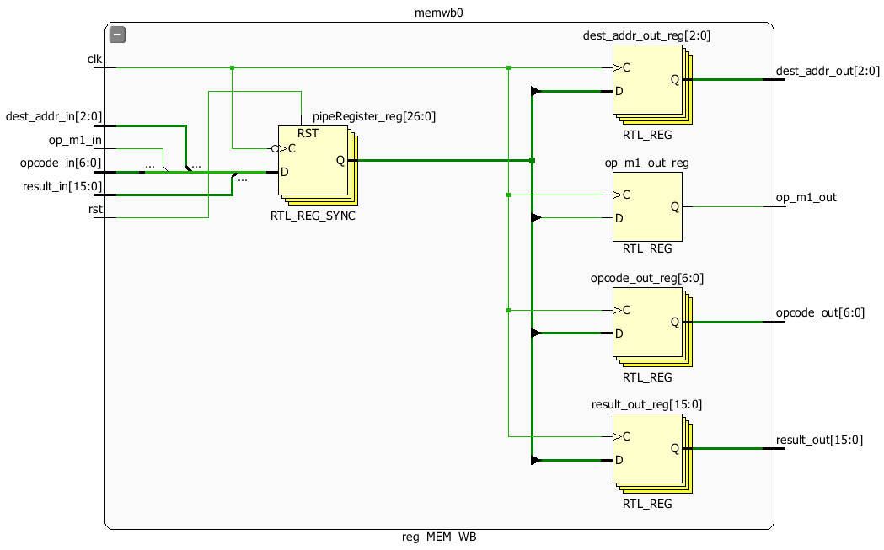
Pipeline Stages – Memory / Writeback – RTL SCHEMATIC, PERFORMANCE
HDL Synthesis Report
Macro Statistics
# Registers : 31
1-bit register : 28
16-bit register : 1
3-bit register : 1
7-bit register : 1
Timing Summary:
---------------
Speed Grade: -5
Minimum period: 2.278ns (Maximum Frequency: 438.982MHz)
Minimum input arrival time before clock: 2.973ns
Maximum output required time after clock: 4.040ns
Maximum combinational path delay: No path found

Slide 18
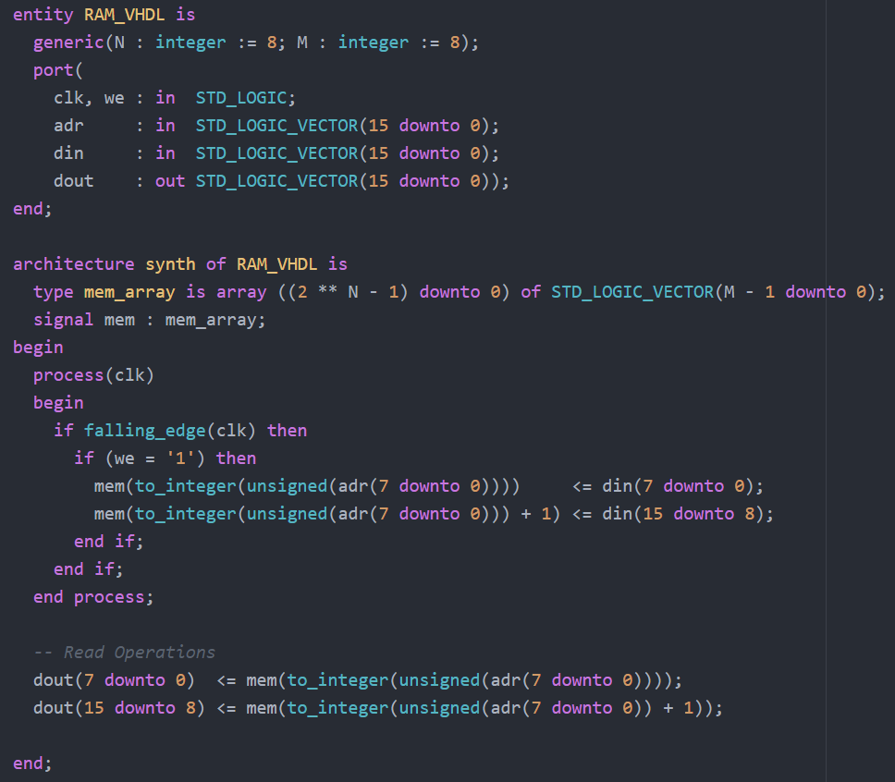
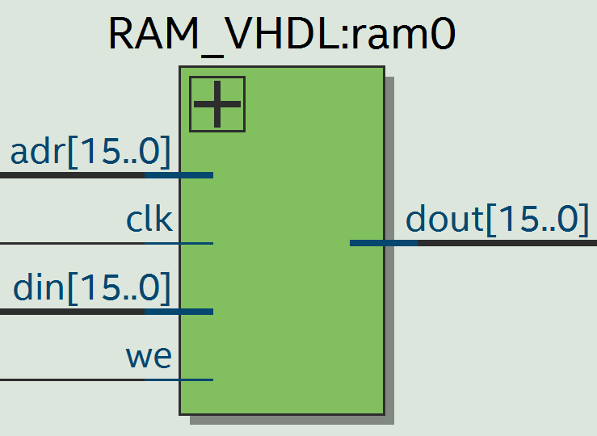
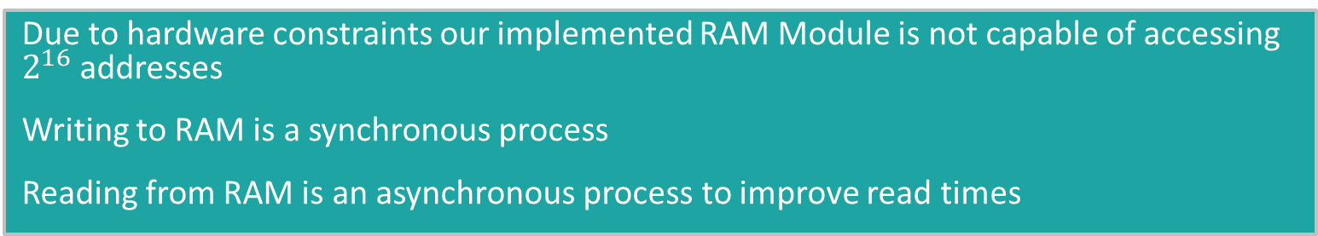
RAM MODULE
Due to hardware constraints our implemented RAM Module is not capable of accessing $2^{16}$ addresses
Writing to RAM is a synchronous process
Reading from RAM is an asynchronous process to improve read times

Slide 19
RAM MODULE – PERFORMANCE
HDL Synthesis Report Macro Statistics # Adders/Subtractors : 1 8-bit adder : 1 # Registers : 272 1-bit register : 16 8-bit register : 256 # Multiplexers : 2 8-bit 256-to-1 multiplexer : 2
Timing Summary:
---------------
Speed Grade: -5
Minimum period: 10.625ns (Maximum Frequency: 94.120MHz)
Minimum input arrival time before clock: 8.257ns
Maximum output required time after clock: 4.040ns
Maximum combinational path delay: No path found
Notes:
Only Performance Metrics Due To RTL Containing Every cell of Memory, we see that memory is the major limiting factor for speed, given more time optimization of memory would be the first place we would look for performance improvements.

Slide 20
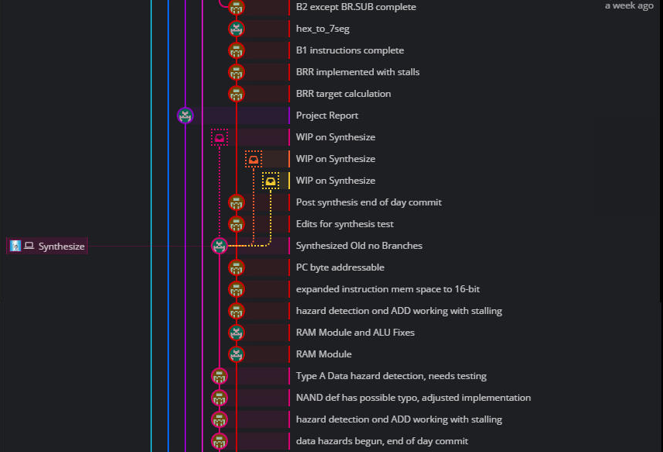
Development Timeline
FINISHING HAZARD DETECTION, STARTING BRANCH INSTRUCTIONS, STARTING USER I/O
Notes:
Transition to Taylor

Slide 21
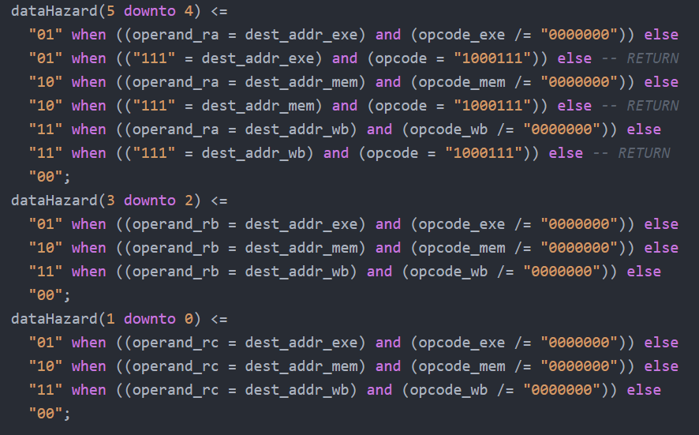
DATA HAZARD DETECTION

Slide 22
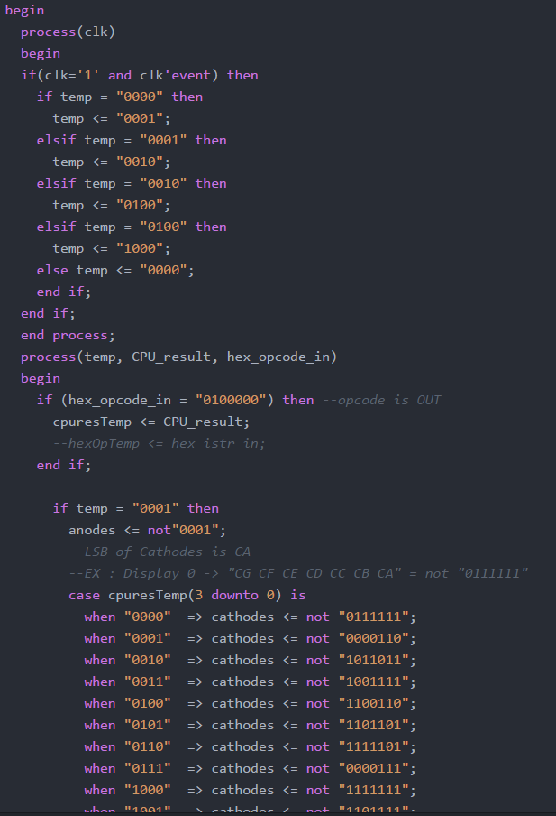
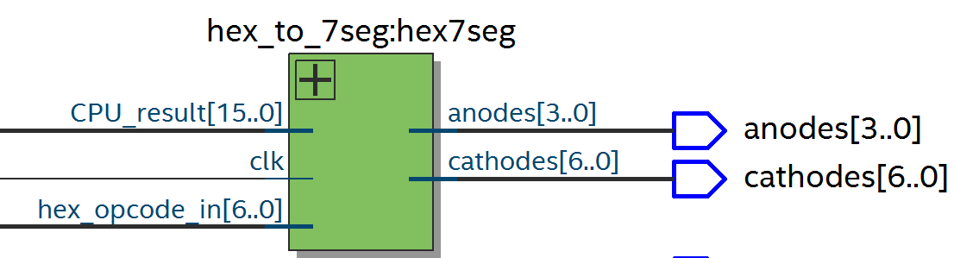
Hex to Seven Segment Display Driver
The Display Driver was designed to only change what is displayed when the opcode indicates an OUT instruction.
Notes:
Transition to Jared

Slide 23
Hex to Seven Segment Display Driver – RTL and PERFORMANCE
Advanced HDL Synthesis Report
Macro Statistics
# FSMs : 1
# Latches : 1
16-bit latch : 1
Timing Summary:
---------------
Speed Grade: -5
Minimum period: 2.396ns (Maximum Frequency: 417.362MHz)
Minimum input arrival time before clock: 1.731ns
Maximum output required time after clock: 9.907ns
Maximum combinational path delay: No path found
Notes:
Hex to Seven Seg Requires a latch for the user i/o switch, given more time would try to optimize all latches down

Slide 24
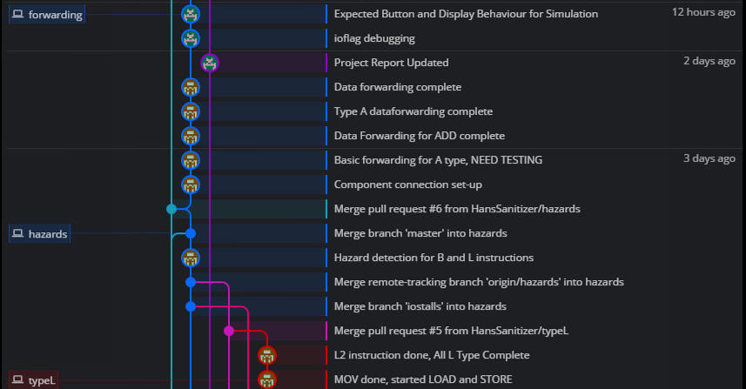
Development Timeline
FINISHING L INSTRUCTIONS, USER I/O DEBUGGING, DATA FORWARDING
Notes:
Taylor

Slide 25
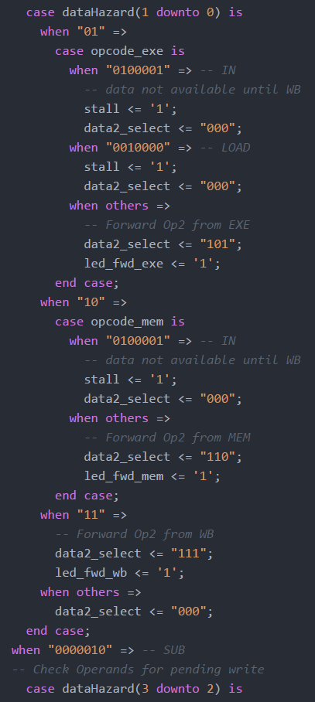
DATA FORWARDING

Slide 26
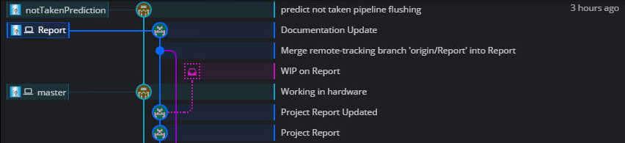
Development Timeline
FINAL TOUCHES – BRANCH PREDICTIONS (COMPLETE), PROJECT REPORT WRITING, HARDWARE DEBUGGING (LATCH REDUCTION, RUNNING TEST CODE – ONGOING)

Slide 27
FULL PROCESSOR SYNTHESIS SUMMARY (SUBJECT TO CHANGE)
Advanced HDL Synthesis Report Macro Statistics # FSMs : 1 # RAMs : 2 255x8-bit single-port block RAM : 1 256x8-bit single-port block RAM : 1 # ROMs : 1 16x3-bit ROM : 1 # Multipliers : 1 8x8-bit multiplier : 1 16-bit 4-to-1 multiplexer : 1 3-bit 4-to-1 multiplexer : 3 # Logic shifters : 2 16-bit shifter logical left : 1 16-bit shifter logical right : 1 | # Adders/Subtractors : 3 16-bit adder : 1 16-bit addsub : 1 8-bit adder : 1 # Registers : 2540 Flip-Flops : 2540 # Latches : 5 1-bit latch : 2 16-bit latch : 2 3-bit latch : 1 # Comparators : 12 16-bit comparator equal : 1 16-bit comparator less : 1 16-bit comparator not equal : 1 3-bit comparator equal : 9 # Multiplexers : 70 1-bit 256-to-1 multiplexer : 16 1-bit 4-to-1 multiplexer : 18 1-bit 8-to-1 multiplexer : 32
Timing Summary:
Speed Grade: -5
Minimum period: 21.547ns (Maximum Frequency: 46.410MHz)
Minimum input arrival time before clock: 5.285ns
Maximum output required time after clock: 11.939ns
Maximum combinational path delay: No path found

Slide 28
Looking Back – All Goals Met
FINAL SUMMARY – PROBLEM SOLUTION
Implemented a RISC like 16-Bit Processor
The Processor is capable of handling all instruction types
The Processor implements a 5-Stage Pipeline Design

Slide 29
Group Project Choices / Additional Features
FINAL SUMMARY
Implemented Branch Prediction (Branch Not Taken Assumption)
Implemented Data Forwarding
Implemented User I/O, holding the process to allow for user input, pressing a button to continue until next user input, or output display

Slide 30
Title and Content Layout with Chart

Slide 31
Two Content Layout with Table
First bullet point here
Second bullet point here
Third bullet point here
Class | Group 1 | Group 2
Class 1 | 82 | 95
Class 2 | 76 | 88
Class 3 | 84 | 90

Slide 32
Two Content Layout with SmartArt
First bullet point here
Second bullet point here
Third bullet point here
Task 1
Task 2
Task 3

Slide 33
Add a Slide Title - 2

Slide 34
Add a Slide Title - 3

